Slide 1
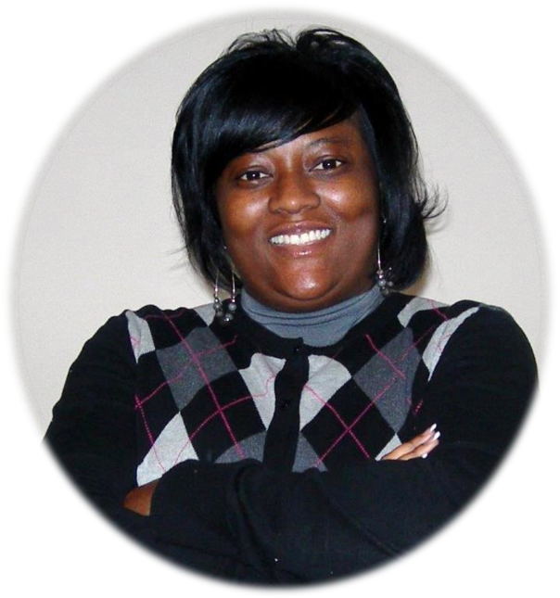
Orange County Contracting Academy
Business Development Division
VaSantha “Tonya” Raysor Administrator

Slide 2
AGENDA
MISSION & PURPOSE
HOW IS THIS ACHIEVED?
PROGRAM/CORE SERVICES
COMMON BIDDER MISTAKES
CHANGES
QUESTIONS
1

Slide 3
MISSION & PURPOSE
Promote the participation and the awarding of contracts to:
Minority and women-owned businesses in accordance with the M/WBE Ordinance.
Register Service-Disabled Veterans (SDV) in accordance with the SDV Ordinance.
2

Slide 4
HOW IS THIS ACHIEVED?
By certifying and utilizing small businesses in the procurement process to achieve goals:
25% Construction
27% Professional Services
24% Services
10% Goods
3

Slide 5
PROGRAM/CORE SERVICES
Certify & Re-certify M/WBE firms
Conduct monthly certification
& How to do Business workshops
Attend Pre-bid/Pre-proposal
meetings to discuss M/WBE project
goals
4

Slide 6
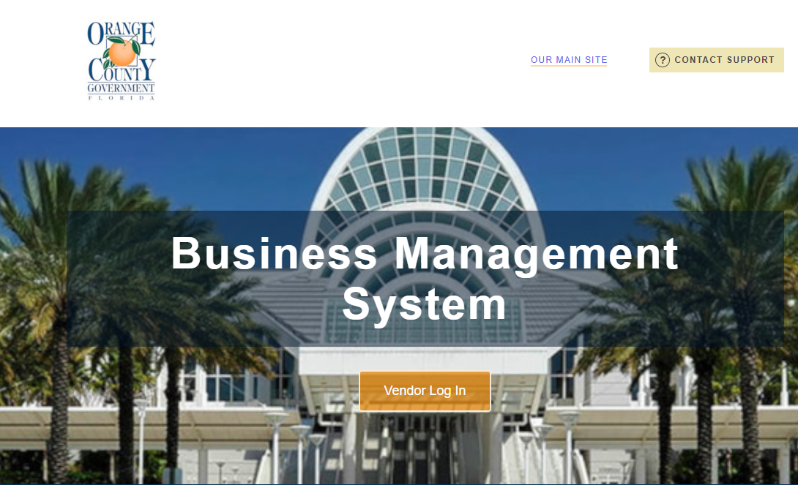
PROGRAM/CORE SERVICES CONTINUED
On-line certification using B2GNOW
https://ocfl.diversitycompliance.com/?TN=ocfl
5

Slide 7
PROGRAM / CORE SERVICES CONTINUED
Participate in Community Outreach events
Evaluate M/WBE utilization on all Invitation for Bids (IFB)
Evaluate M/WBE utilization on all Request for Proposals (RFP)
6

Slide 8
PROGRAM / CORE SERVICES CONTINUED
IFBs for Good and Service have Bid Preference for M/WBEs and Registered SDV bidding as Prime
All RFPs have bonus points awarded for:
a. Registered SDV primes (5 points)
b. SDV sub consultants (2 points for each, 10 pts max)
c. Displaced workers (1 point, 5 points max for each
person hired for project duration)
7

Slide 9
PROGRAM / CORE SERVICES CONTINUED
Contract Compliance
Letters of Intent (LOI) for RFP’s
Executed Subcontract Agreement
Review thoroughly
Dollar amount of percentage of work matches LOI
Prompt Payment Provision
Termination Clause
Terms (Contingent upon Prime’s contract)
8

Slide 10
PROGRAM / CORE SERVICES CONTINUED
Contract Compliance Continued
Compliance Reporting on required reports
Construction (Monthly Reporting)
Goods & Services (Quarterly Reporting)
Professional Services (Quarterly Reporting)
- M/WBE mediation
- Site visits
9

Slide 11
PROGRAM/CORE SERVICES CONTINUED
Educational workshops
- Certification
(Held the second
Monday of each month
from 2-4 PM)
10

Slide 12
PROGRAM / CORE SERVICES CONTINUED
Educational workshops
- How to do Business with
Orange County (Held the
third Monday of each month
from 10-12 noon)
11

Slide 13
PROGRAM / CORE SERVICES CONTINUED
Educational workshops
- Good Faith Effort Open
Forum (Held the first Monday of
each month from 4-5 PM)
- To obtain a copy of the presentation, visit
https://www.ocfl.net/VendorServices/MinorityVendors.aspx
12

Slide 14
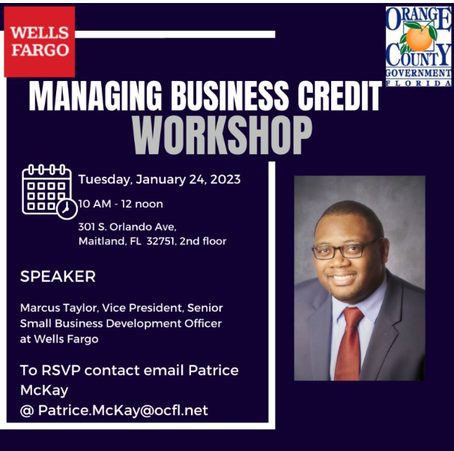
PROGRAM / CORE SERVICES CONTINUED
Educational workshops
- Community Partners -
topics vary (insurance/bonding, the reviewing of legal documents, estimating, joint ventures, how to become a successful firm, etc.)
(Held every quarter)
13

Slide 15
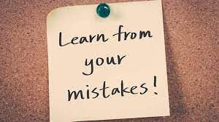
COMMON BIDDING MISTAKES
Automated forms not completed in their entirety or correctly.
Automated forms are not uploaded with bid.
M/WBE’s are listed for scope of services for which they are not certified in.
M/WBE firms are not certified by Orange County.
14

Slide 16
COMMON BIDDING MISTAKES CONTINUED
Letters of Intents not included (for RFP’s).
Different percentages for the same M/WBE firm.
Construction M/WBE goals are not achieved and documents illustrating efforts made to achieve the goals (Good Faith Effort) are not submitted.
15

Slide 17
CHANGES
August 11, 2020 The Board of County Commissioners (BCC) updated the M/WBE Ordinance. Construction bidders are required to:
1. Achieve construction goals or,
2. Submit the required GFE documentation with
bid
January 1, 2023 BDD forms added to E-procurement
16

Slide 18
Questions?? Business Development BusinessDevelopment@ocfl.net
Orange County Contracting Academy

